Slide 1


Slide 3

Key Factors: Blood pressure, cholesterol, lifestyle.
Symptoms: Early detection.
Proactive Measures: Exercise, nutrition, stress management.
Goal: Resilient heart through awareness and proactive measures.

Slide 5
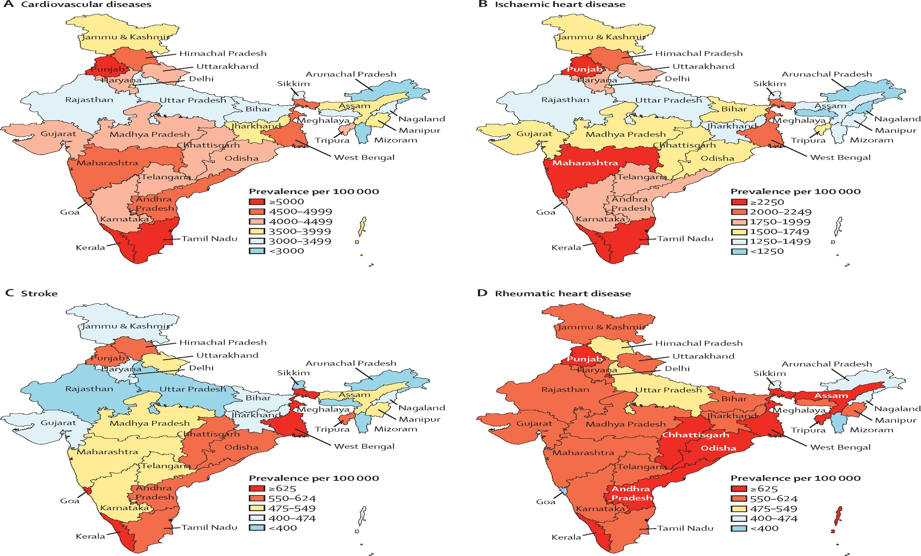

Slide 6
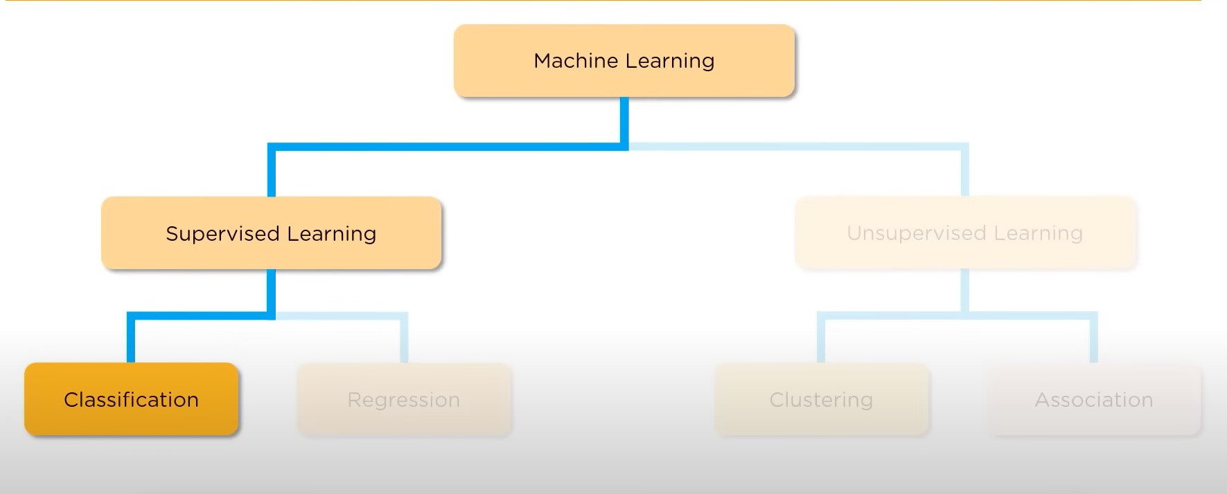

APPROACH TO IDEA

Slide 7

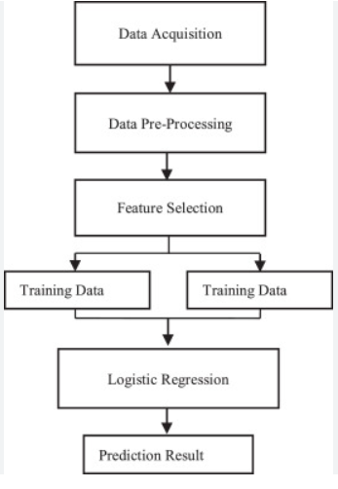

Slide 8
1
DATA PREPROCESSING
FOUR STEPS OF PYTHON PROGRAMMING
include
Mounting drive to colab.
Reading data from the drive.
Analysing data by checking shape columns of data.
Checking null values and duplicate values.

Slide 9
1
DATA PREPROCESSING
2
DATA VISUALIZATION
3
LOGISTIC REGRESSION
4
CALCULATING ACCURACY
Mounting drive to colab.
Reading data from the drive.
Analysing data by checking shape columns of data.
Checking null values and duplicate values.
Visualising data through different graphs lie pie chart and bar graphs.
Finding the relationship between different and drawing inferences
Splitting data into training and testing models.
Applying logistic regression for the training model.
Testing the accuracy by using the testing model which was seperated from the data previously.

Slide 10
1.
DATA PREPROCESSING
1.
Importing libraries
2.
Mounting drive into the colab notebook and reading data from the drive
3.
Analysing the dataset.
shape of the graph
columns of the graphs.
checking null values
checking the presence of duplicates
checking mean,min,etc. using describe function.
4.
Dividing numerical and categorial data
5.
creating a deep copy of our data set and converting all the columns to numerical values

Slide 11
1.
DATA PREPROCESSING
1.
Importing libraries
2.
Mounting drive into the colab notebook and reading data from the drive
3.
Analysing the dataset.
shape of the graph
columns of the graphs.
checking null values
checking the presence of duplicates
checking mean,min,etc. using describe function.
4.
Dividing numerical and categorial data
5.
creating a deep copy of our data set and converting all the columns to numerical values

Slide 12
1.
DATA PREPROCESSING
1.
Importing libraries
2.
Mounting drive into the colab notebook and reading data from the drive
3.
Analysing the dataset.
shape of the graph
columns of the graphs.
checking null values
checking the presence of duplicates
checking mean,min,etc. using describe function.
4.
Dividing numerical and categorial data
5.
creating a deep copy of our data set and converting all the columns to numerical values

Slide 13
1.
DATA PREPROCESSING
1.
Importing libraries
2.
Mounting drive into the colab notebook and reading data from the drive
3.
Analysing the dataset.
shape of the graph
columns of the graphs.
checking null values
checking the presence of duplicates
checking mean,min,etc. using describe function.
4.
Dividing numerical and categorial data
5.
creating a deep copy of our data set and converting all the columns to numerical values

Slide 14
1.
DATA PREPROCESSING
1.
Importing libraries
2.
Mounting drive into the colab notebook and reading data from the drive
3.
Analysing the dataset.
shape of the graph
columns of the graphs.
checking null values
checking the presence of duplicates
checking mean,min,etc. using describe function.
4.
Dividing numerical and categorial data
5.
creating a deep copy of our data set and converting all the columns to numerical values

Slide 15
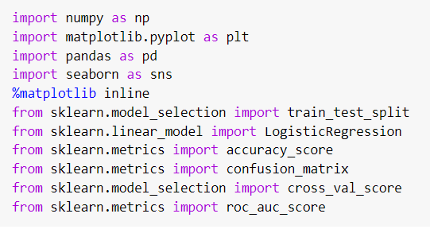
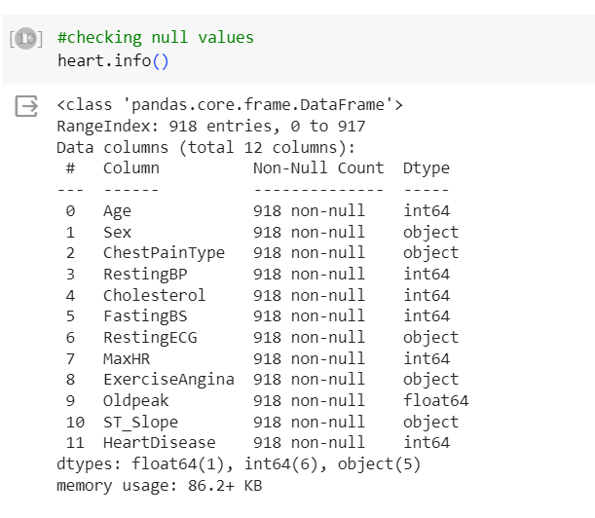
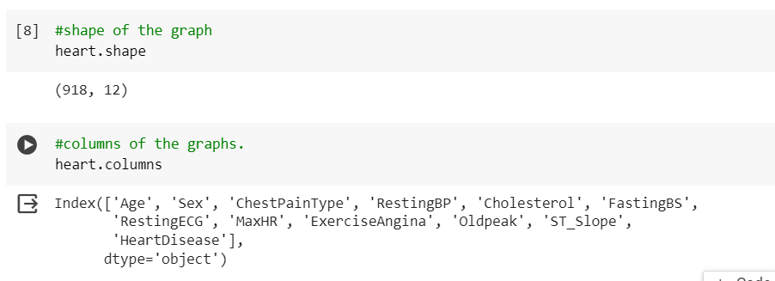
IMPORTING LIBRARIES
Analysing the dataset

Slide 16
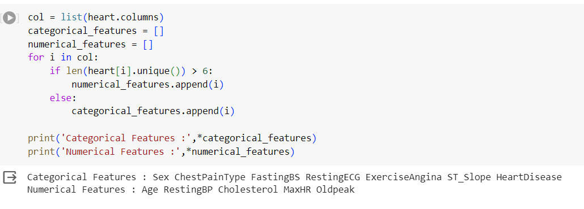
Dividing numerical and categorial data

Slide 17
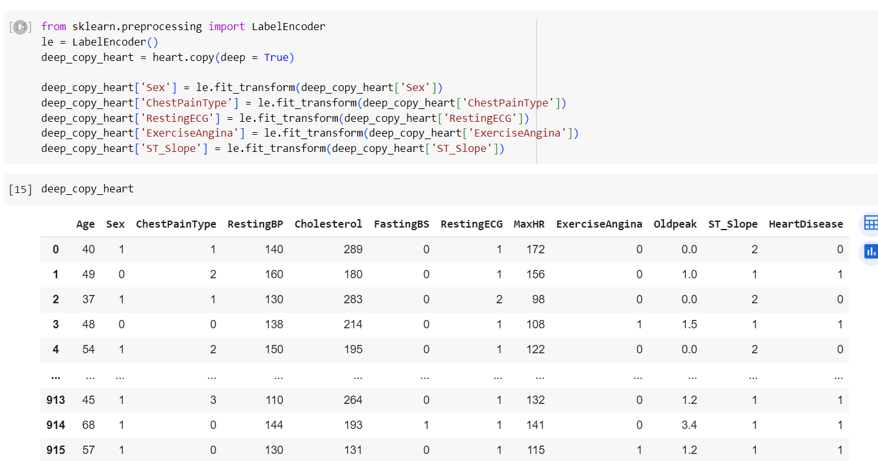
creating a deep copy of our data set and converting all the columns to numerical values

Slide 18
2.
DATA VISUALISATION
1.
visualizing the count of the total no. of heart diseased people along with people without heart disease
2.
Aanalysing the data by plotting graph for different scenario.

Slide 19
2.
DATA VISUALISATION
1.
visualizing the count of the total no. of heart diseased people along with people without heart disease
2.
Aanalysing the data by plotting graph for different scenario.

Slide 20
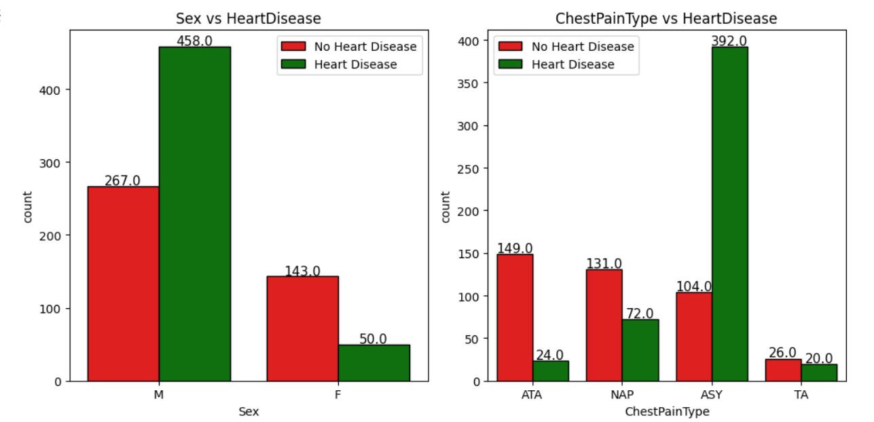
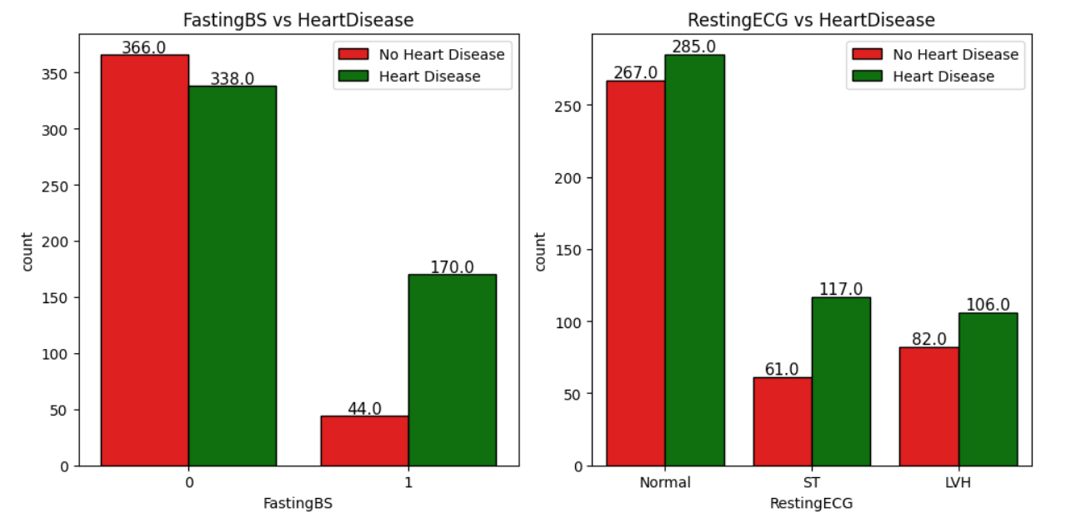
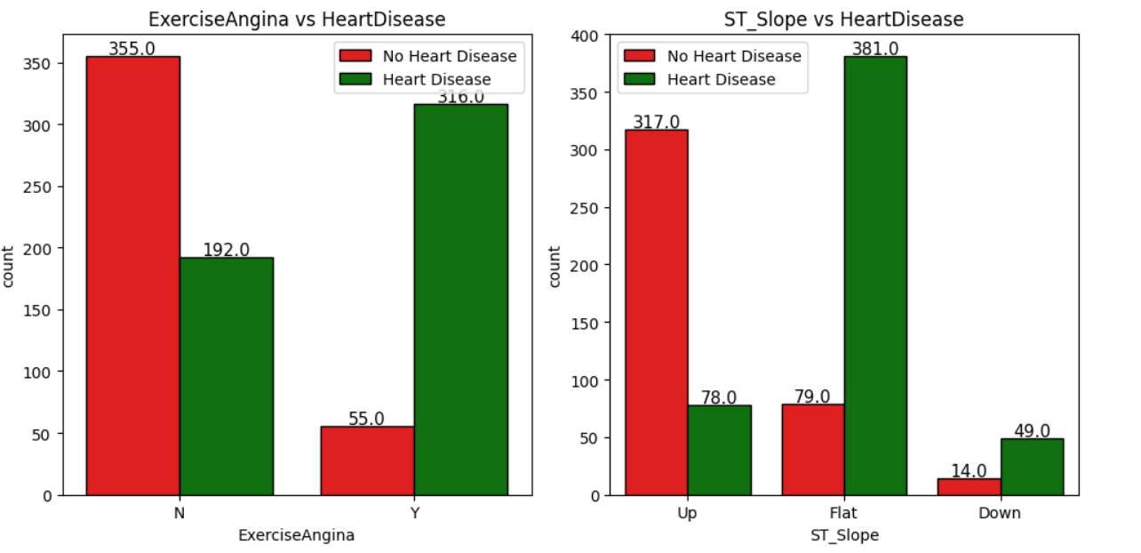

Slide 21
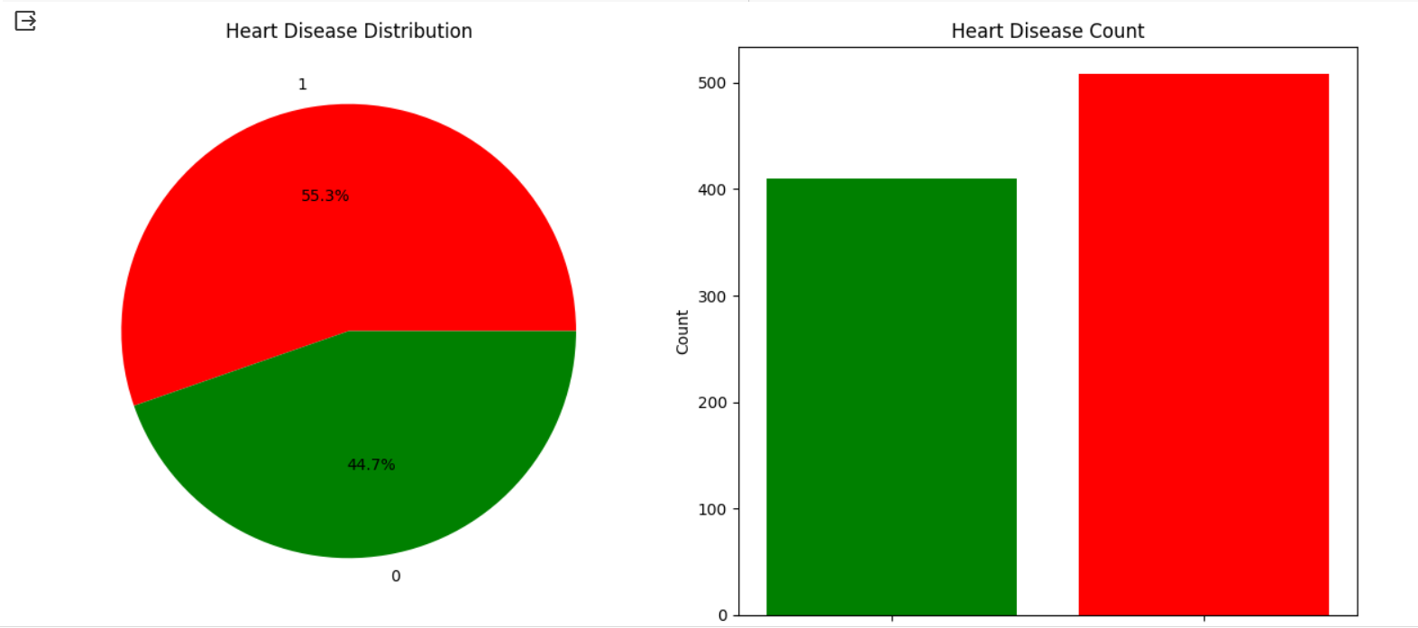

Slide 22
3.
LOGISTIC REGRESSION
2.
Applying Logistic Regression
3.
Fitting model
1.
Splitting the data into training and testing sets

Slide 23
3.
LOGISTIC REGRESSION
1.
Splitting the data into training and testing sets
3.
Fitting model
2.
Applying Logistic Regression

Slide 24
3.
LOGISTIC REGRESSION
1.
Splitting the data into training and testing sets
2.
Applying Logistic Regression
3.
Fitting model

Slide 25
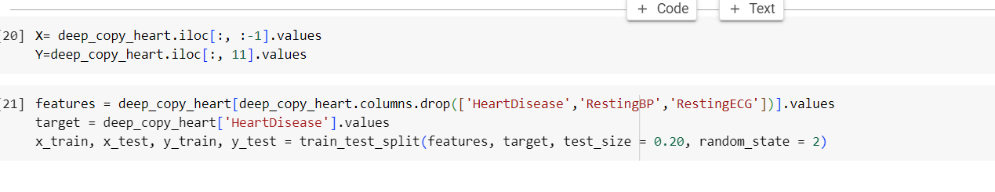
Splitting the data into train and test data
Applying logistic regression and fitting the model

Slide 26
4.
TESTING THE MODEL

Slide 27
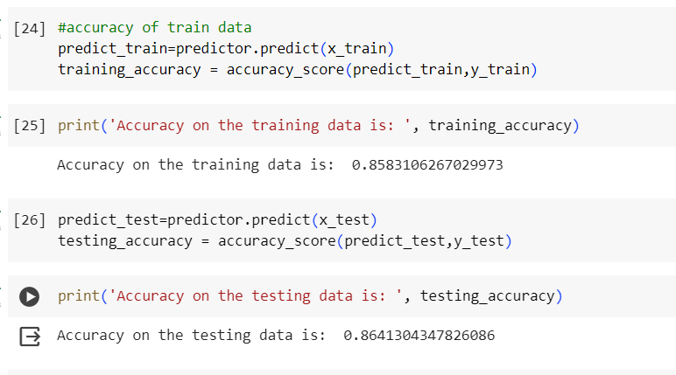
Testing the model we have trained
Obtained an accuracy of 85.83% for training model.
Obtained an accuracy of 86.41% for testing model.

Slide 28
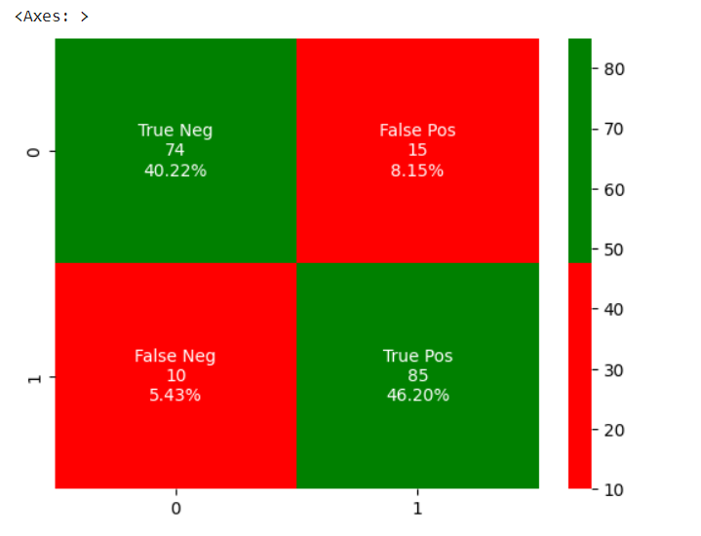
Confusion Matrix

Slide 29
THANK YOU
A HEALTHY HEART IS A
HAPPY HEART

